Slide 1
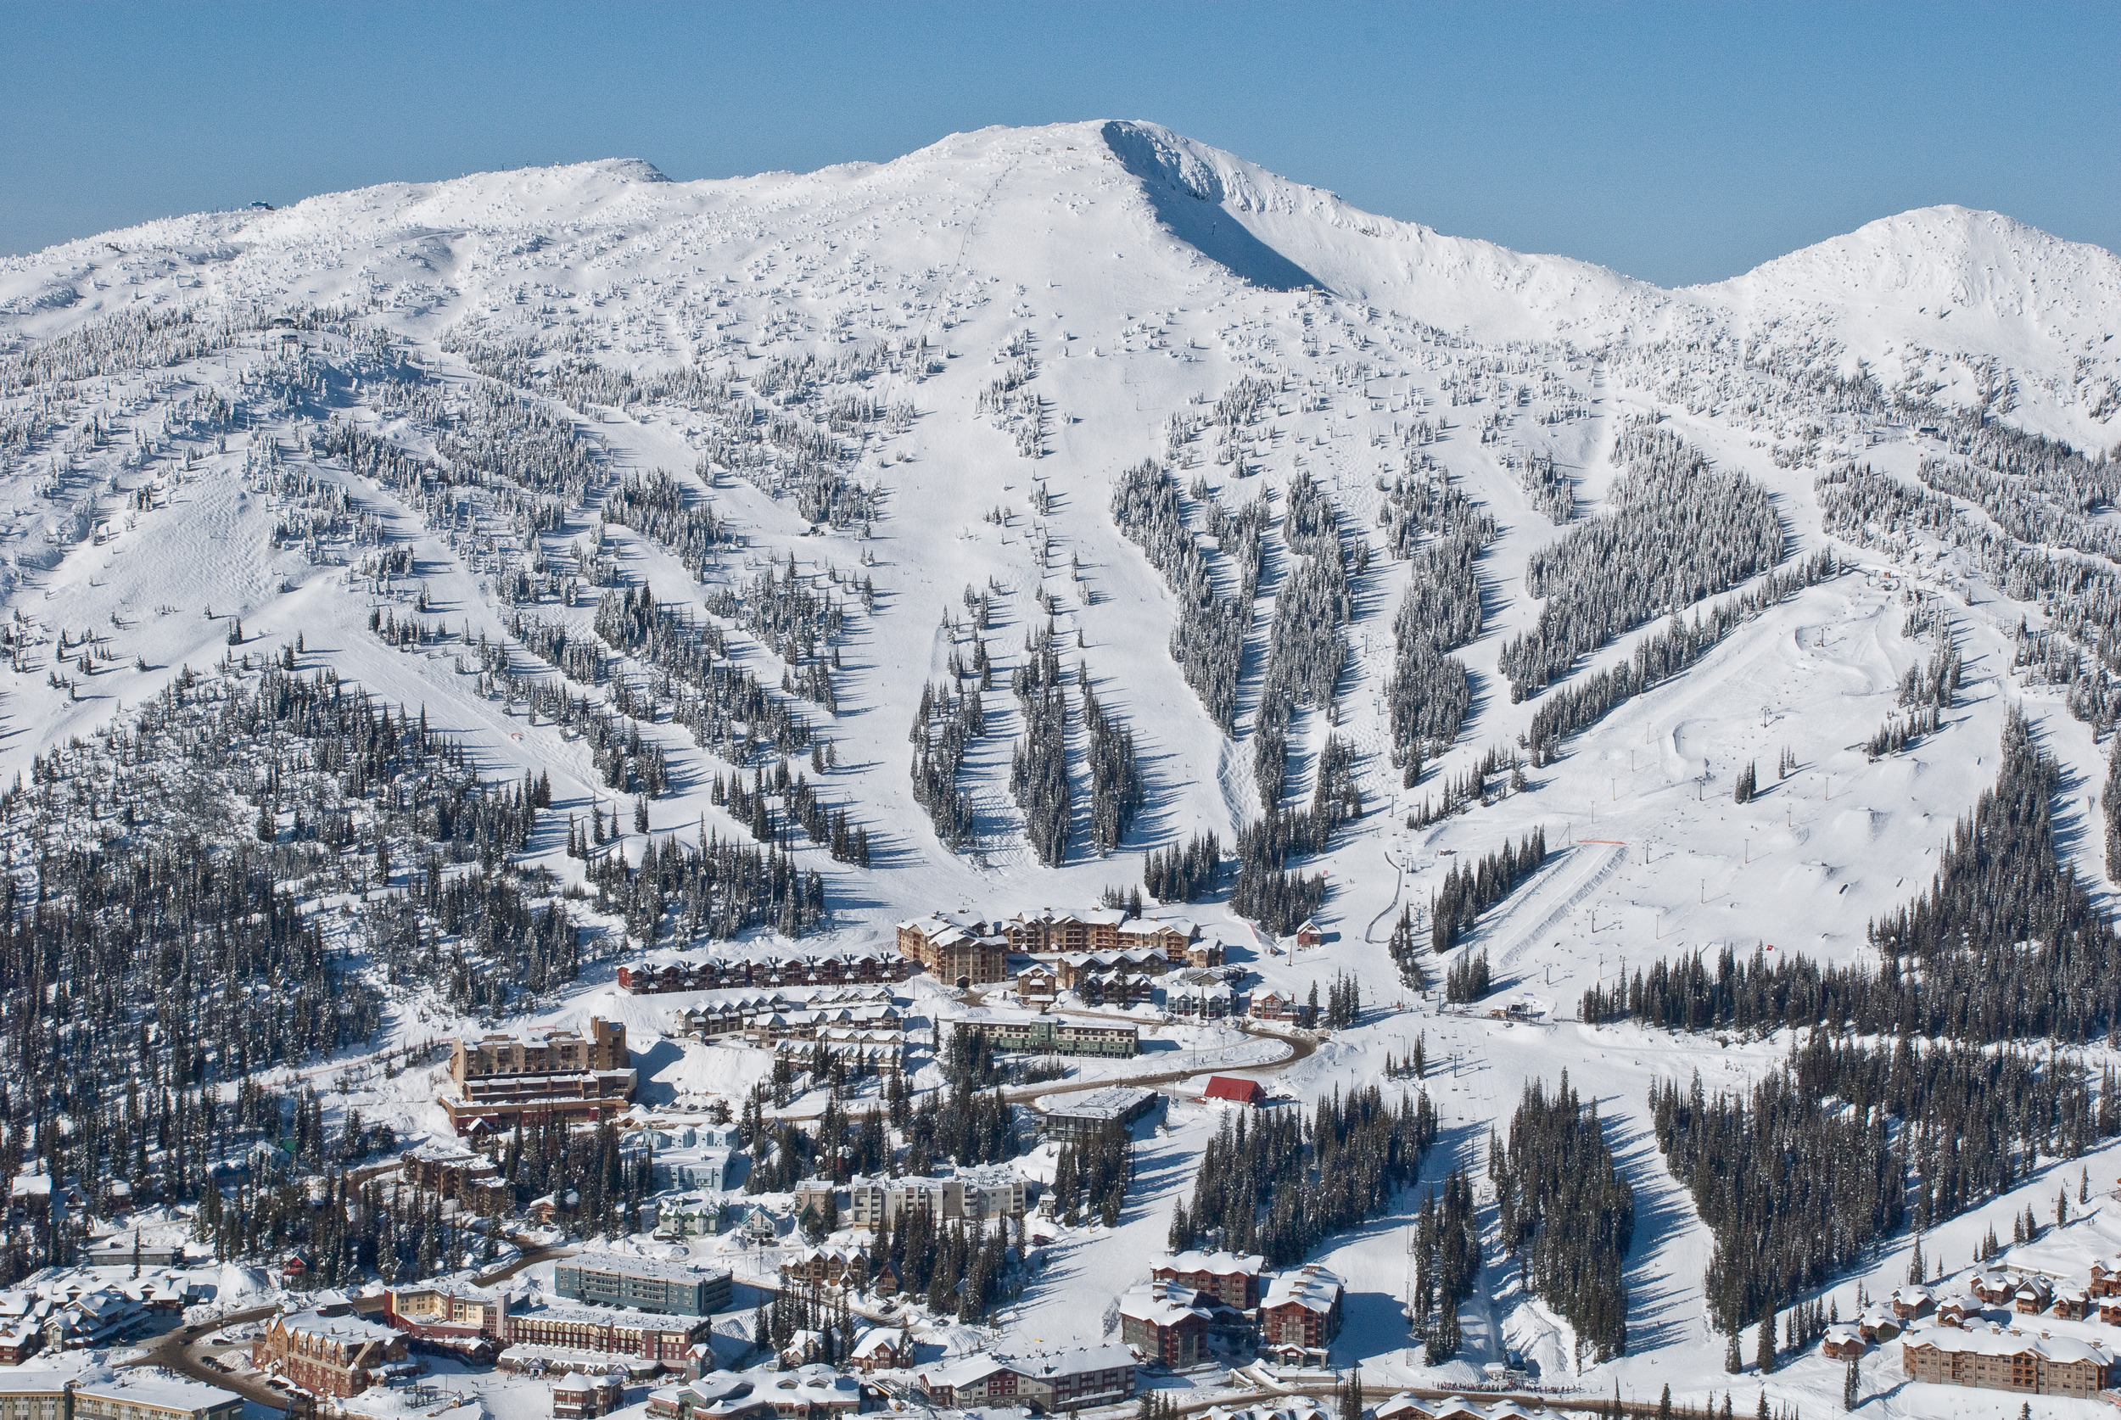
Big Profits: How Big Mountain Resort can increase its earnings by millions
Bernard Wittmaack
Photo credit: https://www.onthesnow.com/british-columbia/big-white/ski-resort.html

Slide 2
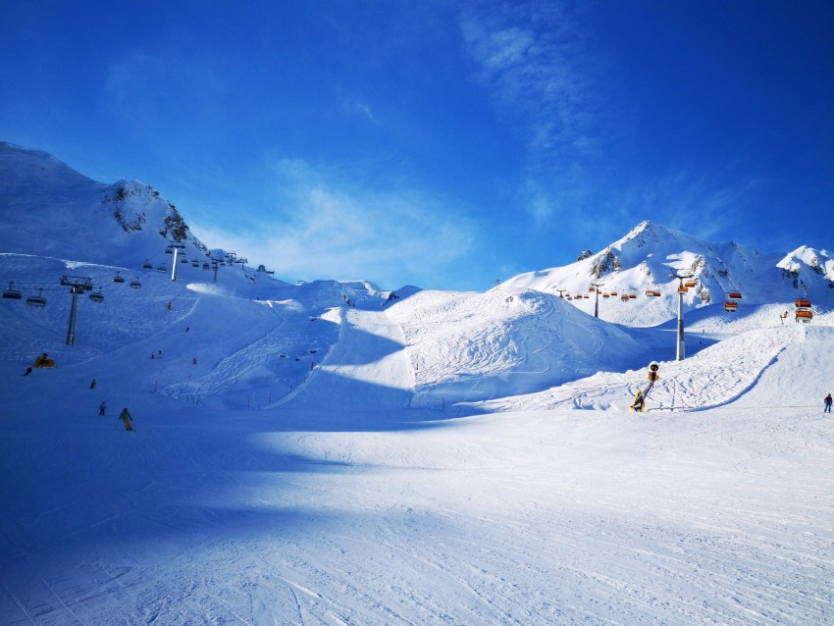
Overview
Big Mountain Resort (BMR) serves over 350,000 skiers and snowboarders of all levels each season.
Recent chairlift built to better distribute skiers across the resort increased operating costs over $1.5M per season.
Although the ticket prices at BMR are above market average, could they be adjusted to increase profits?
How and where should BMR invest (and divest) to continue increasing profit margins.
Can profits be increased at least $1.5M by next season to offset the recent increase in operating expenses?
Photo Credit: https://toppng.com/wallpaper/mountains-ski-track-slope-ski-lifts/448965

Slide 3
Summary of Recommendations and Findings
Analyzed data from 276 ski resort with similar market share to BMR across the United States and predicted ticket price with a random forest model.
BMR can raise its adult weekend ticket price to over $95. Assuming 350,000 seasonal visitors each buying a 5-day pass, BMR would stand to increase its revenue by $24.5M per year at no additional operating costs.
Adding another run to increase BMR’s vertical drop is predicted to increase revenue by $3.5M. Even with another chairlift, this addition should prove profitable.
Eliminating less popular trails could decrease operating costs without much loss in revenue.
Photo Credit: https://toppng.com/wallpaper/mountains-ski-track-slope-ski-lifts/448965

Slide 4
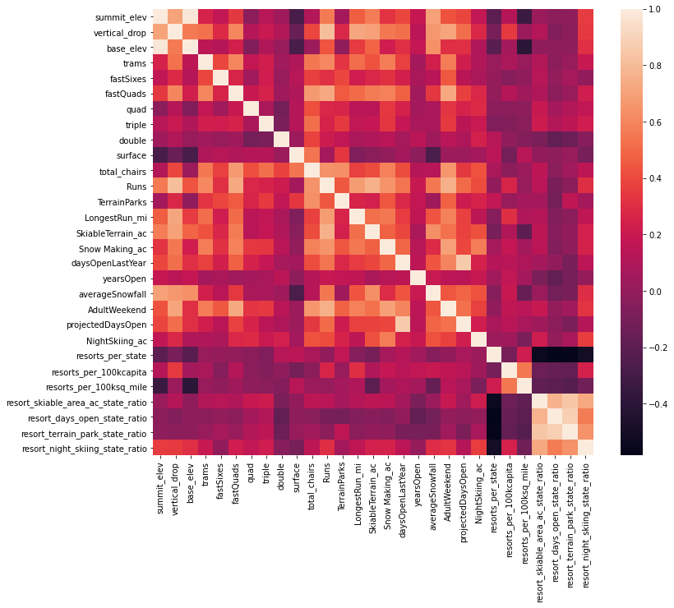
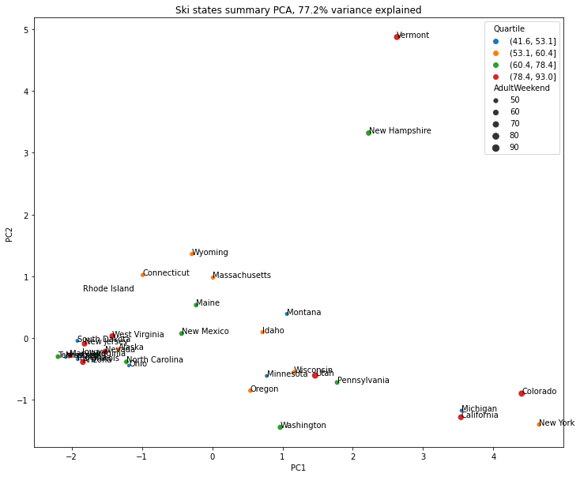
What are important predictors of price?
Strong correlations between ticket price and number of fast quads, number of runs, vertical drop, tram count, and snow making acreage.
Reducing 7 numerical state related variables (e.g., resorts per capita, resorts per area) to 2 via PCR, we determine that the state the resort is located in does not strongly affect ticket price.
Photo Credit: https://toppng.com/wallpaper/mountains-ski-track-slope-ski-lifts/448965

Slide 5
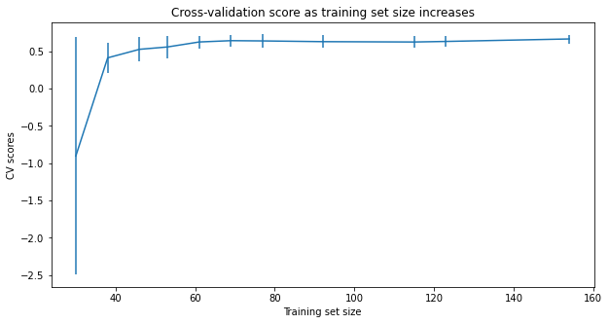
Machine Learning Modeling and Evaluation
Three models tested
Simple Mean (baseline): MAE = $19.14
Linear Regression: MAE = $11.79
Random Forest: MAE = $9.54 (best model)
Pipeline steps:
Imputation of missing values (mean or median)
Standardization scaling of values
Linear model included best K feature selection based on univariate statistics
Model fitting
Five-fold cross validation of 70% of data for training.
Enough data in set for statistically significant conclusion (see learning curve)
Photo Credit: https://toppng.com/wallpaper/mountains-ski-track-slope-ski-lifts/448965

Slide 6
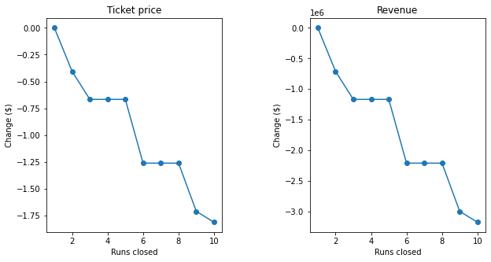
Model Predictions
Scenario | Ticket Price/Seasonal Revenue Increase
1) Permanently closing down up to 10 of the least used runs. | Up to -$1.81 (-$3.2M)
2) Increase the vertical drop by adding a run to a point 150 feet lower down but requiring the installation of an additional chair lift to bring skiers back up, without additional snow making coverage. | $1.99 ($3.5M)
3) Same as number 2 but adding 2 acres of snow making cover. | $1.99 ($3.5M)
4) Increase the longest run by 0.2 mile to boast 3.5 miles length, requiring an additional snow making coverage of 4 acres. | No effect ($0)
Our model predicts that ticket price does not suffer after closing additional run. For example, the ticket price is the same between 3-5 closed runs.
Closing less popular runs may not significantly reduce the ticket price visitors are willing to pay.
Photo Credit: https://toppng.com/wallpaper/mountains-ski-track-slope-ski-lifts/448965

Slide 7
Conclusions and Future Work
Big Mountain Resort’s ticket prices can be increased to $95 to generate up to $24.5M additional seasonal revenue without affecting operating costs. This conclusion comes from applying a random forest model to a dataset of facilities from peer ski resorts across the country.
Using our model, we predict that adding a trail to increase BMR’s vertical drop can further increase revenue by $3.5M, leading to a profit of $2M when accounting for the required chairlift.
Eliminating a number of less popular runs to reduce operation costs is a subject for future research.
BMR is well positioned relative to its peers in many important facilities. However, the resort has zero trams, and tram number is correlated with ticket price. This is another direction for future research.
Photo Credit: https://toppng.com/wallpaper/mountains-ski-track-slope-ski-lifts/448965

